Slide 1
React State
Dr. Adeel Ansari

Slide 2
State
Right now, we're storing our character data in an array in a variable, and passing it through as props.
This is good to start, but imagine if we want to be able to delete an item from the array.
With props, we have a one way data flow, but with state we can update private data from a component.

Slide 3
State
You can think of state as any data that should be saved and modified without necessarily being added to a database - for example, adding and removing items from a shopping cart before confirming your purchase.
To start, we're going to create a state object.
App.js
class App extends Component {
state = {}
}

Slide 4
State
The object will contain properties for everything you want to store in the state. For us, it's characters.
Move the entire array of objects we created earlier into state.characters.
App.js
class App extends Component {
state = {
characters: [],
}
}

Slide 5
State
App.js
Our data is officially contained in the state.
Since we want to be able to remove a character from the table, we're going to create a removeCharacter method on the parent App class.
class App extends Component {
state = {
characters: [
{
name: 'Charlie',
// the rest of the data
},
],
}
}
To retrieve the state, we'll get this.state.characters using the same ES6 method as before.
To update the state, we'll use this.setState(), a built-in method for manipulating state.
We'll filter the array based on an index that we pass through, and return the new array.

Slide 6
State
App.js
You must use this.setState() to modify an array.
Simply applying a new value to this.state.property will not work.
removeCharacter = (index) => {
const {characters} = this.state
this.setState({
characters: characters.filter((character, i) => {
return i !== index
}),
})
}
filter does not mutate but rather creates a new array, and is a preferred method for modifying arrays in JavaScript.
This particular method is testing an index vs. all the indices in the array, and returning all but the one that is passed through.

Slide 7
State
Now we have to pass that function through to the component, and render a button next to each character that can invoke the function. We'll pass the removeCharacter function through as a prop to Table.
App.js
render() {
const { characters } = this.state
return (
<div className="container">
<Table characterData={characters} removeCharacter={this.removeCharacter} />
</div>
)
}

Slide 8
Since we're passing it down to TableBody from Table, we're going to have to pass it through again as a prop, just like we did with the character data.
In addition, since it turns out that the only components having their own states in our project are App and Form, it would be best practice to transform Table into a simple component from the class component it currently is.
Table.js
const Table = (props) => {
const {characterData, removeCharacter} = props
return (
<table>
<TableHeader />
<TableBody characterData={characterData} removeCharacter={removeCharacter} />
</table>
)
}

Slide 9
Here's where that index we defined in the removeCharacter() method comes in.
In the TableBody component, we'll pass the key/index through as a parameter, so the filter function knows which item to remove.
We'll create a button with an onClick and pass it through.
The onClick function must pass through a function that returns the removeCharacter() method, otherwise it will try to run automatically.
const TableBody = (props) => {
const rows = props.characterData.map((row, index) => {
return (
<tr key={index}>
<td>{row.name}</td>
<td>{row.job}</td>
<td>
<button onClick={() => props.removeCharacter(index)}>Delete</button>
</td>
</tr>
)
})
return <tbody>{rows}</tbody>
}

Slide 10
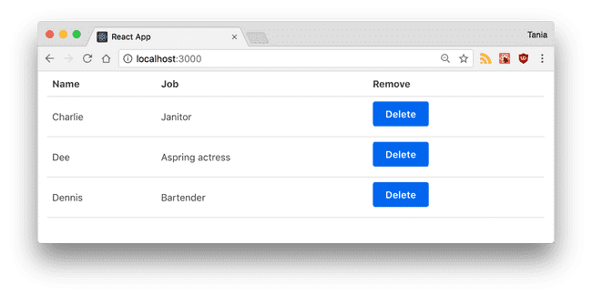
State
Awesome. Now we have delete buttons, and we can modify our state by deleting a character.

